Slide 1




NFH (original); 31, 4
NFHD2; 40, 4
D2: delete 36-72
Rerun alg on D2
NFH (phos); 36, 4
NFHD2 (phos); 33, 4
Note: not currently doing this

Slide 2







Slide 3

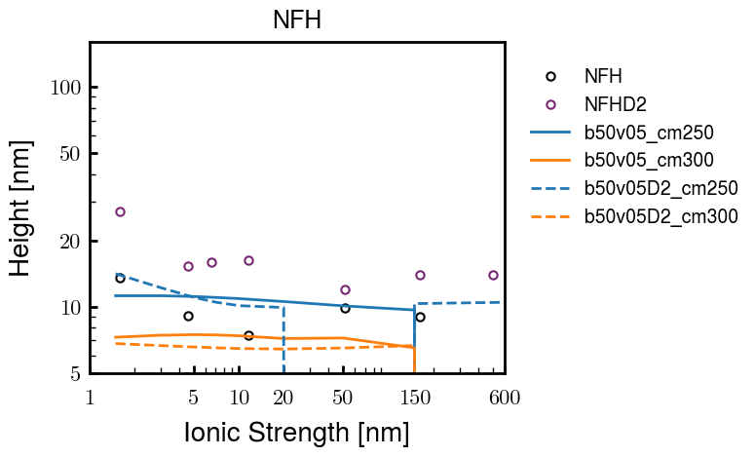


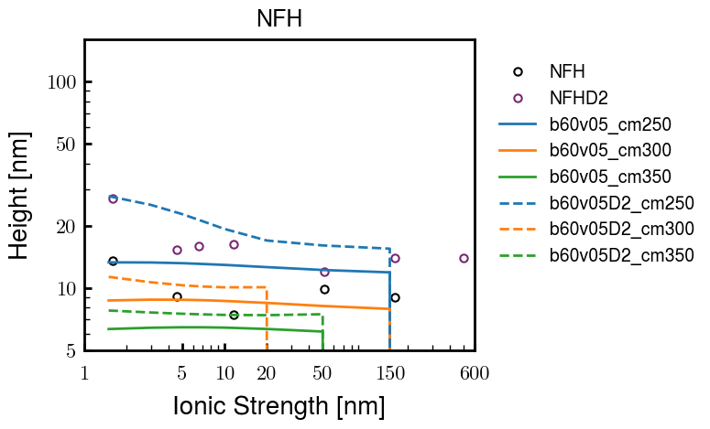


Slide 4



Slide 5



 | Slope Bins 4 | Smear Count 25
Block number | Alpha w/ Henderson Hasselbalch | Chi Chi_max = 2.2
[0 50] | 0.040012 | 1.160000
[50 75] | -0.278451 | 0.720000
[75 125] | -0.519707 | 0.608000
[125 156] | -0.154453 | 0.529032

Slide 6


 | Slope Bins 4 | Smear Count 31
Block number | Alpha w/ Henderson Hasselbalch | Chi Chi_max = 2.2
[0 31] | 0.001103 | 0.922581
[31 62] | -0.386873 | 0.703226
[62 93] | -0.290146 | 0.967742
[93 496] | 0.037164 | 1.098759
[496 527] | -0.064533 | 0.819355
[527 620] | 0.010682 | 0.756989
[620 647] | -0.103326 | 0.696296

Slide 7






Previous
New

Slide 8





Slide 9


Response to stimuli given composition
Same data
Effect of composition given environment

Slide 10


NFL, pH 7.44, phos 1.5e (locs from LCMS)
Non-phos NFL
Block number | Alpha w/ Henderson Hasselbalch | Chi Chi_max = 3.2
[0 50] | 0.040012 | 1.540000
[50 75] | -0.278451 | 0.960000
[75 125] | -0.519707 | 0.868000
[125 156] | -0.154453 | 0.690323
 | Slope Bins 4 | Smear Count 25
Block number | Alpha w/ Henderson Hasselbalch | Chi Chi_max = 3.2
[0 50] | -0.019988 | 1.540000
[50 75] | -0.278451 | 0.960000
[75 125] | -0.519707 | 0.868000
[125 156] | -0.154453 | 0.690323

Slide 11


NFM, pH 7.44, phos 1.5e (locs from LCMS)
 | Slope Bins 4 | Smear Count 32
Block number | Alpha w/ Henderson Hasselbalch | Chi Chi_max = 3.0
[0 32] | 0.079143 | 1.275000
[32 64] | -0.186340 | 1.125000
[64 96] | -0.327964 | 1.181250
[96 160] | -0.460694 | 0.787500
[160 224] | -0.124999 | 1.115625
[224 288] | -0.023510 | 0.956250
[288 352] | -0.242085 | 1.003125
[352 384] | -0.031302 | 1.125000
[384 416] | -0.123860 | 1.050000
[416 438] | 0.046945 | 1.281818

Slide 12





Bin 3 NFM, pH 7.44, phos 1.5e (locs from LCMS)

Slide 13




Bin 5 NFM, pH 7.44, phos 1.5e (locs from LCMS)

Slide 14



Phos 2 NFM, pH 7.44, phos 2.0e (locs from LCMS)

Slide 15



Chi 2.5 NFM, pH 7.44, phos 2.0e (locs from LCMS)

Slide 16



NFM, pH 7.44, non-phos

Slide 17


NFH, pH 7.44, phos 1.5e (locs from LCMS)
 | Slope Bins 4 | Smear Count 36
Block number | Alpha w/ Henderson Hasselbalch | Chi Chi_max = 3.2 | Chi Chi_max = 3.0
[0 36] | 0.000945 | 1.266667 | 1.20000
[36 72] | -0.527455 | 0.900000 | 0.85000
[72 324] | -0.208376 | 1.729365 | 1.628571
[324 396] | -0.111195 | 1.416667 | 1.333333
[396 432] | -0.152824 | 1.344444 | 1.266667
[432 647] | -0.033955 | 1.077209 | 1.015814

Slide 18




Phos block dashed
Phos block dashed

Slide 19



Best are b3.0 v2.0 and b3.0 v3.0, but max H not high enough
Possible solutions:
Lower chi_max
Change aa_disc to have more charge
Force spectra?
Better for low salt, but high salt will melt brushes together

Slide 20



M1
pMx5

Slide 21



b3.00; v1, 2
b4.00; v2, 2.5, 3, 5, 10
b5.00; v3, 10, 15, 40
53 Nk
39 Nk
32 Nk

Slide 22
Binary results

Slide 23



Matrix Approach
Updated 04/04/2023

Slide 24














H Vol decrease (by v)
H Vol decrease (by b)
Desired “linearity” by tuning /thresh/ based on polymer density of expelled NFL
L Vol decrease (by b)
Comes at severe cost of overall height. Have to minimize outer concentration to approach pure thresh of 1e-06

Slide 25














H Vol decrease (by v)
H Vol decrease (by b)
Chimax 3.5
Desired “linearity” by tuning /thresh/ based on polymer density of expelled NFL
L Vol decrease (by b)
Comes at severe cost of overall height. Have to minimize outer concentration to approach pure thresh of 1e-06

Slide 26








F (3.5)
Chimax 3.5
Chimax 3.0
Scaled by 1.5
Scaled by 1.6
Scaled by 1.6
Scaled by 1.5
Scaled by 1.5
Scaled by 1.5
Scaled by 1.8
Scaled by 1.8

Slide 27
















Last test: same stiffness factor (b^3/v0) but with varying total volume

Slide 28












H Vol decrease (by v)
H Vol decrease (by b)
a2C_30
a2D_30
a2E_30
Rerun for Cs
b1C_30
b1D_30
b1E_30
L Vol decrease (by b)
a1C_30
a1D_30
a1E_30
g1C_30
g1D_30
g1E_30
Rerun for Cs

Slide 29












H Vol decrease (by v)
H Vol decrease (by b)
a2C
a2D
a2E
b1C
b1D
b1E
Block 4 (NFL end)
L Vol decrease (by b)
a1C
a1D
a1E
g1C
g1D
g1E

Slide 30









H Vol decrease (by v)
Chimax 3.5
H Vol decrease (by b)
a2C_30
a2D_30
a2E_30
b1C_30
b1D_30
b1E_30
L Vol decrease (by b)
a1C_30
a1D_30
a1E_30
g1C_30
g1D_30
g1E_30

Slide 31







For i as L and H:
Pure height profiles
Mixed height profiles
Current L library
Current H library
Skip; marginal increase in vol prob not enough
Move onto chi3.0; larger NFL vol library

Slide 32





NFL
All plotting wrong L pure; look only at purp
NFH
H volume too low to neutralize L (v = 31 nm3/c)

Slide 33







H volume v = 60 nm3/c

Slide 34







H volume too low to neutralize L

Slide 35










NFH, V = 70
L30

Slide 36





NFH & NFL v = 0.15
a2D
b1D
g1D

Slide 37





Based on NFH b5v15c3, apply VL = VH
NFL and NFH are from same amino acids but diff chain lengths. Should VL = VH?
L30 / H70
L80 / H20
L30 / H70
L80 / H20

Slide 38






L30 / H70
L80 / H20
L30 / H70
L80 / H20

Slide 39
L Fitting

Slide 40


VL = VH

Slide 41







Try b change, v same as H (0.15)
Phi unrealistic (?)
Phi unrealistic
Phi very unrealistic
Phi very unrealistic

Slide 42






Try similar params to H
5.6
11.2
16.8
28
56
7.5
11.25
18.75

Slide 43







Try similar params to H, b0.36
7.8
15.6
23.4
31.2
Unrealistic vol
Not very sensitive to v; not high enough to intersect neighboring chains (function of b and sigma)

Slide 44


Continuation from prev params

Slide 45







v2.7 and some fine
b1.50 v2.7 c3.2
b1.75 v2.7 c3.2
b1.75 v2.5 c3.2
b1.75 v2.5 c3.0
b2.0 v2.7 c3.2
b2.25 v2.7 c3.2
b2.50 v2.7 c3.2
Phi too small to decrease v0

Slide 46










b2.0 v10.0 c3.0
b2.0 v8.0 c3.0
b2.0 v6.0 c3.0
b2.0 v4.0 c3.0
b2.0 v2.0 c3.0
Phi limit
b1.8 v10.0 c3.0
b1.8 v8.0 c3.0
b1.8 v6.0 c3.0
b1.8 v3.0 c3.0
b1.8 v2.0 c3.0
Phi limit

Slide 47





b1.6 v10.0 c3.0
b1.6 v8.0 c3.0
b1.6 v6.0 c3.0
b1.6 v2.0 c3.0
b1.6 v1.5 c3.0
Phi limit

Slide 48









b2.0 v2.7 c3.2
b3.0 v3.5 c3.5
b3.0 v7.0 c3.5
b3.0 v7.0 c3.0
Phi too small
Phi too small to decrease v0
b4.0 v12.0 c3.0
b5.0 v20.0 c3.0
b5.0 v20.0 c4.0
b5.0 v5.0 c3.0
b5.0 v10.0 c3.0
Phi too small to decrease v0

Slide 49





v20
b5.0 v20.0 c3.0
b4.5 v20.0 c3.0
b4.0 v20.0 c3.0
b3.5 v20.0 c3.0
v10
b5.0 v10.0 c3.0
b4.0 v10.0 c3.0
b3.0 v10.0 c3.0
b2.0 v10.0 c3.0

Slide 50




b2.00 v2.70 c3.20
b2.00 v2.75 c3.20

Slide 51
NFH fitting (from NFL best fit)

Slide 52








b1.00, v0.50, c3.2
b2.00, v4.00, c3.2, th2.5e-02
b1.00, v2.00, c3.2
b1.00, v1.00, c3.2

Slide 53
Mixture

Slide 54



Slide 55


b = 0.75

Slide 56





Slide 57
b = 1.0

Slide 58





Slide 59
b = 1.25

Slide 60




Chi 2.6
Bad vol frac

Slide 61








b25v0
b25v1
b25v2
b25v3

Slide 62




Chi 2.8
Bad vol frac

Slide 63





Slide 64
b = 1.50

Slide 65






Chi 2.8
Bad vol frac

Slide 66





Slide 67

b = 2.00
v4 = 0.25*b^3

Slide 68


Bad vol frac

Slide 69



Slide 70
Fine tune

Slide 71



b1.25, v1.95, c3.0
b1.50, v3.38, c3.0
b2.00, v4.00, c3.0
Norm seems to capture kinked behavior

Slide 72




Slide 73



b1.25, v1.95, c3.2
b1.50, v3.38, c3.2
b2.00, v4.00, c3.2

Slide 74




Slide 75


b1.25
b1.50
b2.00
c2.8
c3.0
c3.2

